Slide 1
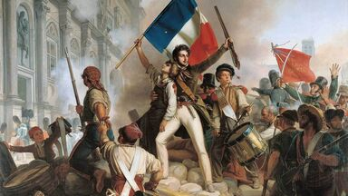


Simulations Can Revolutionize Your Classroom!
A Simulation-based Webinar
Richard Di Giacomo,
M.A. History,
author of the Role-Playing Simulation series of books from Interact

Slide 2
Agenda
Notes:
Jeremy

Slide 3
What are Simulations?
Students assume a historical persona.
Students act/make decisions as their persona would, based upon research.
Within predetermined confines, students make choices that either recreate or change history.
By playing a role, students gain understanding of how historical decisions were made and empathy for those involved in historical changes.
Notes:
Jeremy

Slide 4
What is a role-playing simulation?
Role-playing simulations attempt to put the student in the position of a person in a particular time and place
All of the simulations involve group problem solving and conflict resolution
Usually centered around a time of crisis or decision making
Notes:
Richard

Slide 5

So, you say you want a revolution? Well, alright. We all want to teach the world.
World Revolutions can be one of the most challenging units to teach in World History.
Complex ideologies
Complicated personalities
Archaic primary sources
Endless cycles of conflict
How am I going to teach all this to students with no background in it?

Slide 6
Simulations work well with concepts that are difficult to teach with other methods:
Abstract thoughts
Philosophies
Political platforms
Treaties
Negotiations
Revolutions
Complex war strategies
Instead of knocking yourself out trying to explain these difficult concepts through a dull readings, lecture, or film, it is far more effective to have students live them out by doing a simulation.
Then the concepts become their own!

Slide 7
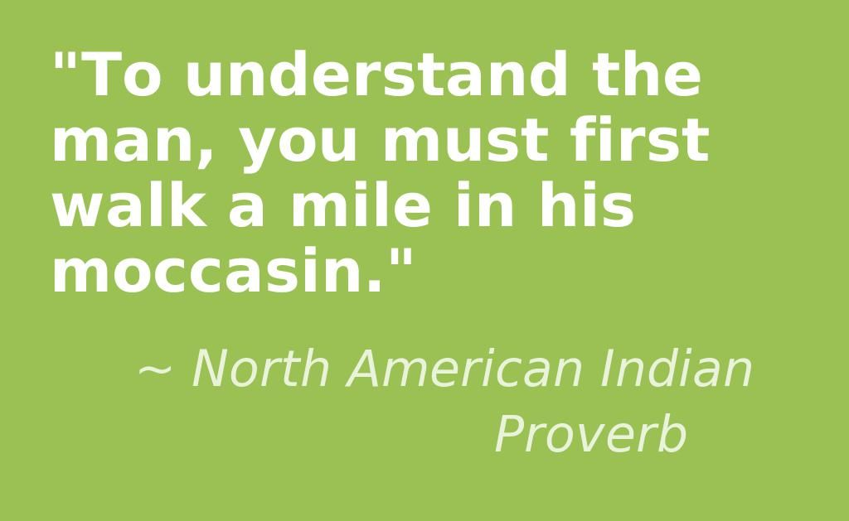
Simulations Help Develop Empathy
Remember the old parable about walking a mile in another man’s moccasins?
Simulations literally put you in the place of another person. You have to understand their world view, background, needs, and desires.
To play a role honestly and free from anachronisms, you must think as they would think, and do what they would do, not substitute your own modern values and priorities. You must become that person as an actor would.
By doing so you have to get beyond your own prejudices, biases, and preconceived notions.
This teaches you to understand others from the past better!

Slide 8
Students Learn History Without Even Realizing They Are Doing It
The students are so caught up in the fun and competition of the game, that they don’t even realize how much historical content they are absorbing while doing it.
While playing the historical roles and solving problems, they are opening a window into the thought processes of historical characters, and beginning to understand why they did what they did.

Slide 9
Simulations Are a Great Motivator
Difficult or disengaged students will participate even if they usually are not involved in class activities.
Students who like a little extra attention will thrive on the special roles they get to play.
Gifted students will have a chance to shine as they are easily able to differentiate the activity and take it to a whole new level.
All students will enjoy the change of pace from ordinary routines.

Slide 10
Simulations improve comprehension and test scores
Studies have shown that simulations help students to grasp difficult concepts better and retain them longer
Test scores and grades have improved after doing simulations
They can be used as a scaffolding activity, basic form of instruction, or authentic assessment.
They can be used to introduce or sum up a unit.
Simulations are much more than a reward or change of pace activity!

Slide 11
Simulations allow for many enrichment activities. After the simulation you can follow up with:
A debriefing including a discussion of alternate outcomes or how history might have been different with a few changes
Running the simulation again with a different time period, location, or set of characters
An essay or other assessment of what they have learned
A student made film or play
A creative writing assignment
Having students create their own simulation

Slide 12
Examples of World Revolutions simulations
Patriots v. Tories
Exporting the French Revolution
Revolutions of 1848
Risorgimento
Pancho Villa, Hero or Villain?
Russian Revolution
Suffragettes
To Tell the Truth: Gandhi
Revolutionary Debates
Get colonists to join your side
Should other countries copy the French revolution?
Students create a revolutionary pamphlet
Factions compete to unite Italy
Create poster that is pro or anti-Pancho Villa
Factions compete to rule Russia
Students plan strategies to promote women’s rights
Decide which gameshow contestant is the real Napoleon
Take sides on various revolutionary topics

Slide 13
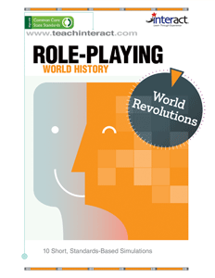
Role-Playing World Revolutions
Print-Based or
E-book
© 2021 Interact www.teachinteract.com

Slide 14
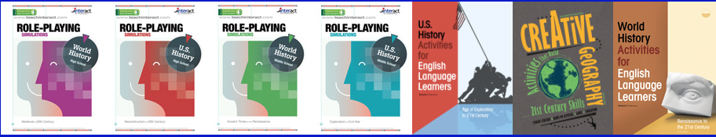
Other books containing simulations about revolutions
Interact simulations the Role-playing Simulations series by Richard Di Giacomo and others contain activities on the
American Revolution
French Revolution
American Civil War
Imperialism and others
Social Studies School Service
  www.socialstudies.com
Notes:
Brad

Slide 15
Conclusion
  If you have a complicated subject to get across to your students, it may be much easier to teach by using a simulation.
  Students will have a much better grasp of ideologies, political parties, revolutionaries, and the cause and effect of events if they act them out themselves.
  Instead of students getting lost or bored, they will comprehend revolutions well and be talking about the roles they played for days afterward!
Break out of your comfort zone and try them. You will be richly rewarded!
Notes:
Brad

Slide 16
Thank you for attending
Any questions?

Slide 17
References
Bloom, B. & Krathwohl, D. (1984). Taxonomy of Educational Objectives. Book 1: Cognitive Domain. White Plains, NY: Longman
Cyber Nation Simulations. (2008). Accessed on 6-28-2008 at www.cybernations.net
Di Giacomo, R. (2002). Short Role Playing Simulations for US History. San Jose, CA: Magnifico Publications.
Duncombe, S., & Heikkinen, M. H. (1990, January/February). Role-playing for different viewpoints. Social Studies, 81(1), 33-35.
Education Services & Staff Development Association of Central Kansas. Social Studies Central. Accessed on 6-23-2008 at http://www.socialstudiescentral.com/?q=node/88
Gardner, H. (1983). Frames of Mind: The Theory of Multiple Intelligences. New York: Basic Books.
Grauerholz, E., & Scuteri, G. M. (1989, October). Learning to role-take: A teaching technique to enhance awareness of the "other". Teaching Sociology, 17(4), 480-483.
Impact Games. (2008). Play the News. Accessed on 6-28-2008 at http://www.playthenewsgame.com/community/home.action
Kannan, S. (2008). Beyond the Fire: Teen Experiences in War. Accessed on 6-28-2008 at http://www.itvs.org/beyondthefire/
Karjala, H. E., & White, R. E. (1983, November). American history through music and role play. History Teacher, 17(1), 33-59.
Kitzerow, P. (1990, April). Active learning in the classroom: The use of group role plays. Teaching Sociology, 18(2), 223-225.
Lamey, S. (1983). Teaching About Global Awareness with Simulation and Games. Center for Teaching International Relations, Univ of Denver. Denver, CO: CTIR Publications
Lee, J. (1994). Effectiveness of the Use of Simulations in a Social Studies Classroom. Curry School of Education, University of Virginia. Eric Document Number 381448. Accessed on 5-23-2008 at http://eric.ed.gov/ERICWebPortal/custom/portlets/recordDetails/detailmini.jsp?_nfpb=true&_&ERICExtSearch_SearchValue_0=ED381448&ERICExtSearch_SearchType_0=no&accno=ED381448
Maidment, M. & Bronstein, R.H. (1973). Simulations Games: Design and Implementation. Columbus, Charles E. Merrill.
Nesbitt, W.A. (1971). Simulation Games for the Social Studies Classroom. Foreign Policy Association.
Piage, J. (1972). Development and Learning. In Lavattelly, C.S. & Stendeler, F. Reading in Child Behavior and Development. New York: Hartcourt Brace Janovich.
Population Connection (2008). A Nation of Immigrants. Washington, D.C. Accessed on 6-28-2008 at http://www.populationeducation.org/docs/300millionlessons/immigrtn.pdf
Thatcher, D. (1986). Promoting Learning Through Games and Simulations. Simulations and Games for Learning, 16(4), p. 144-154.
Van Sickle, R. L. (1990). Problem solving in social studies education: Simplifications of research on problem solving and cooperative learning. Journal of Social Studies Research, 14(1), 33-43.

