Slide 1
Best Practices in Using Simulations in the Social Studies
Brad Maguth, The University of Akron
Jeremy Hilburn, University of NC at Chapel Hill
Richard Di Giacomo, Magnifico Publications
Notes:
Jeremy

Slide 2
Agenda
Simulations:
What are they?
The Many Types
The Rationale
Where Are They?
Examples of Simulations
Notes:
Jeremy

Slide 3
What are Simulations?
Students assume a different persona.
Students act/make decisions as their persona would, based upon research.
Some are complicated and take weeks to conduct; others can be done in 5 minutes.
Notes:
Jeremy

Slide 4
Types
1.) Model United Nations
2.) Election
3.) Formal debate
4.) Trial
5.) Social drama
6.) Webquest (sometimes)
7.) Others
Notes:
Brad

Slide 5
Rationale and Use in the Social Studies
Multiple Intelligences: Affective & Psych-Motor (Gardner, 1983)
Critical Thinking & Mult. Persp (Maidment & Bronstein, 1973)
A Real World Replication (Nesbitt, 1971)
Cooperative Learning (Thatcher, 1986)
Piaget’s Play Theory (Piaget, 1972)
Bloom’s Taxonomy: Synthesis (Bloom,1984)
Notes:
Brad

Slide 6
Locating Stimulating Simulations
Print Based
Short Role-Playing Simulations for US History, Di Giacomo (2002)
Teaching About Global Awareness with Simulation and Games, Univ. of Denver (1983)
Simulations for the Social Studies Classroom, Nesbit (1971)
Web Based
Social Studies Central
Cyber Nation Simulations
News Game
Notes:
Brad

Slide 7

Words of Caution
Expect some confusion
Real vs. simulated
Review and modify before implementing
Need to debrief with students & evaluate process
Notes:
Jeremy

Slide 8
Types we’ll explore today
1. Model U.N.
2. Elections
3. Uganda & Child Soldiers
4. Darfur is Dying
5. Immigration
6. Formal Debate
Notes:
Jeremy

Slide 9
Simulation 1: Model U.N.
Source: United Nations Assoc. of U.S.A.
Concept: Students take the roles of U.N. ambassadors to resolve international crises
Skills: Reading, discussion, parliamentary procedure, resolution writing, speech making, and caucus
Benefits: Participation, students grapple with material, high-energy, understand content, relevant, agency, teacher-facilitator, interdisciplinary, higher order thinking
Limitations: Time consuming, should probably purchase the packet, instructional time to teach parliamentary procedure and resolution writing, etc.
Notes:
Jeremy

Slide 10
Simulation 2: Election of 1800
Key points: Students as political leaders and political blocs, national crises, recreate election
Includes: History and civics, writing and public speaking, pre and post activities
Benefits: High energy, active participation, higher order thinking, can be applied to any election, student agency, teacher as facilitator, competitive
Limitations: Low teacher control, competitive, unprepared students
Adaptation 2012: Crises – stimulus packages, still in Afghanistan, high unemployment, Occupy movement; political blocs – unemployed, environmentalists, CEOs, Occupiers, Tea Partiers, etc.
Notes:
Jeremy

Slide 11
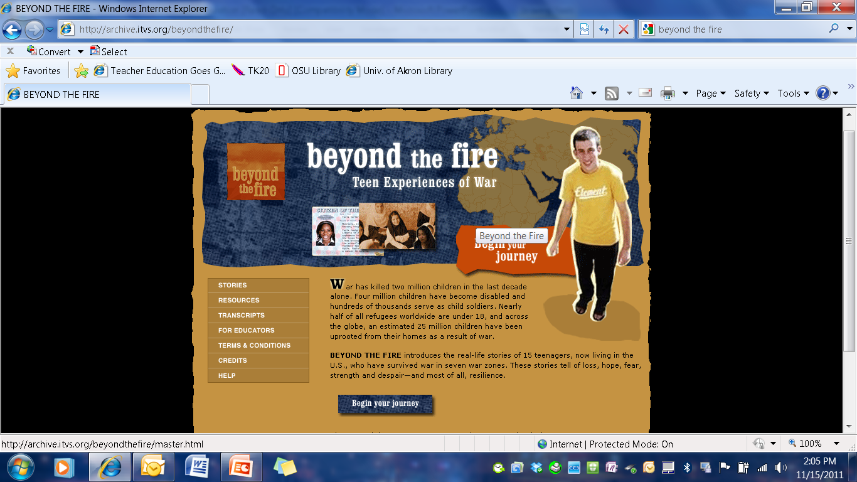
Simulation 3: Uganda & Child Soldiers
Beyond the Fire:
Teen Experiences of War
Key Points:
-Students listen to personal accounts from child soldiers
-Students role play (Historian, a economist, a psychologist, former child soldiers, child soldier family members, and world leaders)
-Teacher moderates discussion
-How should the global community respond to this issue?
Notes:
Brad

Slide 12
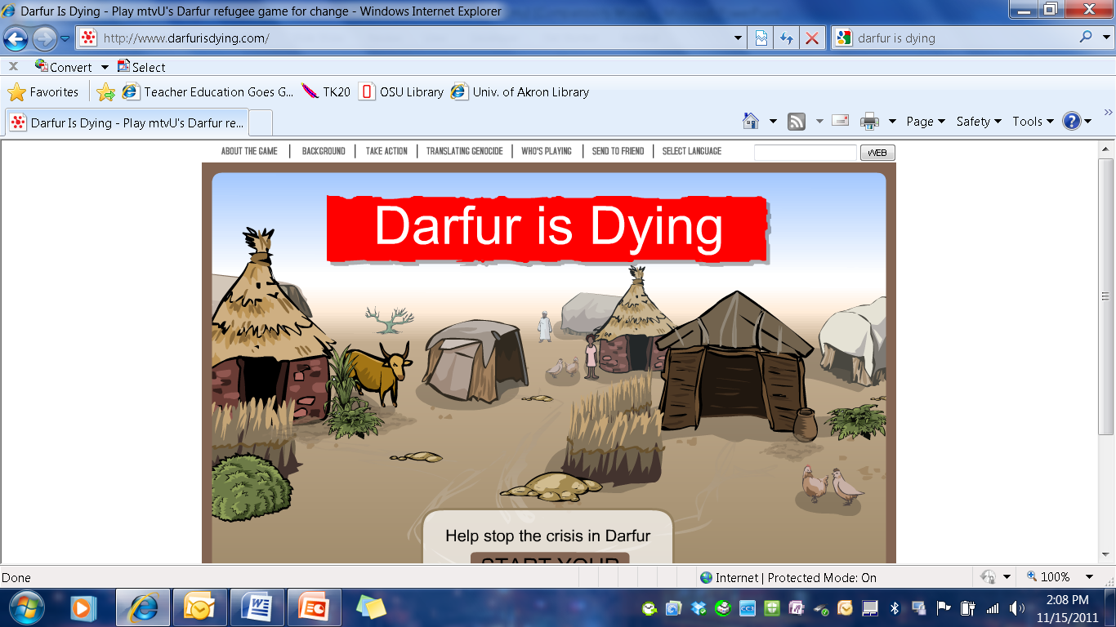
Simulation 4: Darfur is Dying
Darfur Digital Activist Contest: Collaboration Between Student ‘Gamers’ & Activists.
User takes on the perspective of a displaced Darfurian.
Negotiates forces that threaten survival in a refugee camp.
Offers a glimpse of what life’s like for more than 2.5 million refugees in Sudan.
Notes:
Brad

Slide 13

Simulation 5: Immigration
A Nation of Immigrants
-Students divide into two groups
-Tape on floor divides groups
-Only side A gets candy
-Those that come over from B get candy
-Key Questions:
1. How does this simulation resemble immigration?
2. Why have people migrated to the US?
3. What are the impacts of this migration in both state A and B?
Notes:
Brad

Slide 14
Simulation 6: Formal Debate
Resolved: A U.S.-led attack on Iran’s nuclear facilities is constitutional and in the best interest of the U.S. and the world
Notes:
Jeremy

Slide 15
What is a role-playing simulation?
Role-playing simulations attempt to put the student in the position of a person in a particular time and place.
All of the simulations involve group problem solving and conflict resolution.
Usually centered around a time of crisis or decision making.
Notes:
Richard

Slide 16
Two Major types of role-playing simulations
Scripted: the students are given a script to read. The character they are to play is spelled out for them in advance in detail
Unscripted: Students play a part by improvisation based on general historical guidelines for a character provided by the simulation
Notes:
Richard

Slide 17
Advantages & Disadvantages of Scripted Simulations
Advantages of Scripted Role-playing Simulations
Usually well-researched and well-written
Students don’t need a lot of prior knowledge. The script tells them what to do.
Disadvantages:
Usually more costly
Take up a lot of class time
Not as fun to play because students are to confined to a role that may not interest them

Slide 18
Advantages & Disadvantages of Unscripted Simulations
Advantages:
No pre-set limits are placed on a particular person's choices as long as they are within the realm of what was historically possible.
The outcome is very unpredictable. No two classes finish the simulation in the exact same way.
Leads to some very interesting classroom discussions about why things turned out the way they, did, what could have happened differently, and how the simulation compares to what actually occurred in history.

Slide 19
Disadvantages of Unscripted Simulations
Teacher may need to provide some historical context for the simulation if students do not have enough prior knowledge
Some teachers are uncomfortable with not using a structured lesson
The teacher must actively monitor the activity to insure that students are on task and meeting objectives
It is sometimes hard to know when to stop the simulation
Classes doing the simulation may end at different times so coordinating lesson plans may be difficult

Slide 20
Factors to Consider when Choosing a Simulation: Duration
How much time do I have to spend on this activity?
Is the time invested worthwhile to meet my learning objectives?
Will another activity meet my objectives better?
What other activities will I be giving up to do this lesson?
How does it fit into my class calendar and bell schedule?
Do I have a way to keep records of where each class leaves off and picks up each new day?
How long will it hold the interest of my students?

Slide 21
Factors to Consider when Choosing a Simulation: Cost
Many simulations are very costly- up to $50+ for a single game
What are your funding sources? Grants, PTA, Department budgets or out of pocket?
How many simulations are provided in the book?
What are the distribution rights of lesson plans for purchasers of the book?
How much of the materials do you have to reproduce?
Are there many pieces which can be lost and must be replaced?

Slide 22
Factors to Consider when Choosing a Simulation: Student Needs and Abilities
Grade level
Reading level
# of special needs and/or ELL students
How groups will be formed
Students’ prior knowledge of history
Students’ prior experience with simulations, group work, or acting
Form of assessment that the teacher will use

Slide 23
Factors to Consider when Choosing a Simulation: Complexity level
Preparation time for teacher
How much help will the teacher have to run the simulation?
Parents, students, teachers aides or a colleague who is familiar with the activity
Length of rule book
Flexibility of the rules for adaptation to the needs of your students
Amount of support the publisher provides for rules clarification
Clean up and storage of records and pieces

Slide 24
Short Role-playing Simulations for US History Classrooms ISBN 0-9706237-1-2
Table of Contents:
1. Reconstruction Simulation
2. Taking Colonies
3. Great Powers Game (W.W.I)
4. Strike Simulation
5. Dust Bowl Simulation
6. W.W. II Debates
7. Cold War Simulation
8. Cuban Missile Crisis Simulation
9. Hippie Day
10. Vietnam Peace Talks Simulation
11. 20th Century Slang
12. US History Counterfactuals: “What if…?”

Slide 25
Short Role-playing Simulations for Early U.S. History ISBN-10 0983426708
Table of Contents:
1. Native American Fictional Story Writing
2. Map Along with an Explorer
3. Christopher Columbus Trial Teacher's Guide
4. Colonial Charter Simulation
5. “Dear King George…”
6. Tory, Patriot, or Neutral?
7. War of 1812 Simulation
8. Early American Inventors Patent Application
9. Mexican-American War Simulation
10. California Gold Rush Simulation
11. Reformer Resume
12. Underground Railroad Simulation
13. Abolitionist Simulation Teacher's Guide
14. Antebellum Newspaper
15. Secession Convention Teacher’s Guide
16. US History Counterfactuals: What if? Questions

Slide 26
Short Role-playing Simulations for World History Classrooms ISBN 0-9706237-0-4
Table of Contents:
1. Roman Emperor Simulation
2. Medieval Conversation
3. Renaissance Patronage Competition
4. Christopher Columbus Trial
5. Martin Luther Trial
6. French Revolution Simulation
7. Taking Colonies: A World History Writing Assignment
8. Sepoy Revolt Simulation
9. Great Powers Game (W.W.I)
10. W.W.II Debates
11. Cold War Simulation
12. World History Counterfactuals: “What if…?

Slide 27
Short Role-playing Simulations for Middle School World History ISBN 0-9706237-4-7
Table of Contents:
1. Archaeology Lab: Excavate Your School!
2. Invent Your Own Writing System
3. The Mesopotamian Trade Game
4. Monument to a Pharaoh Competition
5. Colonies of the Ancient Mediterranean
6. Roman Soldiers’ Letters Home
7. Roman Emperor Simulation
8. The Mandate of Heaven: The Chinese Dynasty Game
9. Make Your Own Illuminated Manuscript
10. Crusader Job Interview
11. Medieval Conversation
12. Christopher Columbus Trial 13. World History Counterfactuals: “What if?”

Slide 28
Conclusion
Simulations can serve as a means to foster interest and inquiry in the social studies
Students should research, think flexibly, and analyze multiple perspectives
Students become decision makers
Importance of student debriefing and evaluation
Notes:
Brad

Slide 29
References
Bloom, B. & Krathwohl, D. (1984). Taxonomy of Educational Objectives. Book 1: Cognitive Domain. White Plains, NY: Longman
Cyber Nation Simulations. (2008). Accessed on 6-28-2008 at www.cybernations.net
Di Giacomo, R. (2002). Short Role Playing Simulations for US History. San Jose, CA: Magnifico Publications.
Duncombe, S., & Heikkinen, M. H. (1990, January/February). Role-playing for different viewpoints. Social Studies, 81(1), 33-35.
Education Services & Staff Development Association of Central Kansas. Social Studies Central. Accessed on 6-23-2008 at http://www.socialstudiescentral.com/?q=node/88
Gardner, H. (1983). Frames of Mind: The Theory of Multiple Intelligences. New York: Basic Books.
Grauerholz, E., & Scuteri, G. M. (1989, October). Learning to role-take: A teaching technique to enhance awareness of the "other". Teaching Sociology, 17(4), 480-483.
Impact Games. (2008). Play the News. Accessed on 6-28-2008 at http://www.playthenewsgame.com/community/home.action
Kannan, S. (2008). Beyond the Fire: Teen Experiences in War. Accessed on 6-28-2008 at http://www.itvs.org/beyondthefire/
Karjala, H. E., & White, R. E. (1983, November). American history through music and role play. History Teacher, 17(1), 33-59.
Kitzerow, P. (1990, April). Active learning in the classroom: The use of group role plays. Teaching Sociology, 18(2), 223-225.
Lamey, S. (1983). Teaching About Global Awareness with Simulation and Games. Center for Teaching International Relatins, Univ of Denver. Denver, CO: CTIR Publications
Lee, J. (1994). Effectiveness of the Use of Simulations in a Social Studies Classroom. Curry School of Education, University of Virginia. Eric Document Number 381448. Accessed on 5-23-2008 at http://eric.ed.gov/ERICWebPortal/custom/portlets/recordDetails/detailmini.jsp?_nfpb=true&_&ERICExtSearch_SearchValue_0=ED381448&ERICExtSearch_SearchType_0=no&accno=ED381448
Maidment, M. & Bronstein, R.H. (1973). Simulations Games: Design and Implementation. Columbus, Charles E. Merrill.
Nesbitt, W.A. (1971). Simulation Games for the Social Studies Classroom. Foreign Policy Association.
Piage, J. (1972). Development and Learning. In Lavattelly, C.S. & Stendeler, F. Reading in Child Behavior and Development. New York: Hartcourt Brace Janovich.
Population Connection (2008). A Nation of Immigrants. Washington, D.C. Accessed on 6-28-2008 at http://www.populationeducation.org/docs/300millionlessons/immigrtn.pdf
Thatcher, D. (1986). Promoting Learning Through Games and Simulations. Simulations and Games for Learning, 16(4), p. 144-154.
Van Sickle, R. L. (1990). Problem solving in social studies education: Simplifications of research on problem solving and cooperative learning. Journal of Social Studies Research, 14(1), 33-43.

