Slide 1
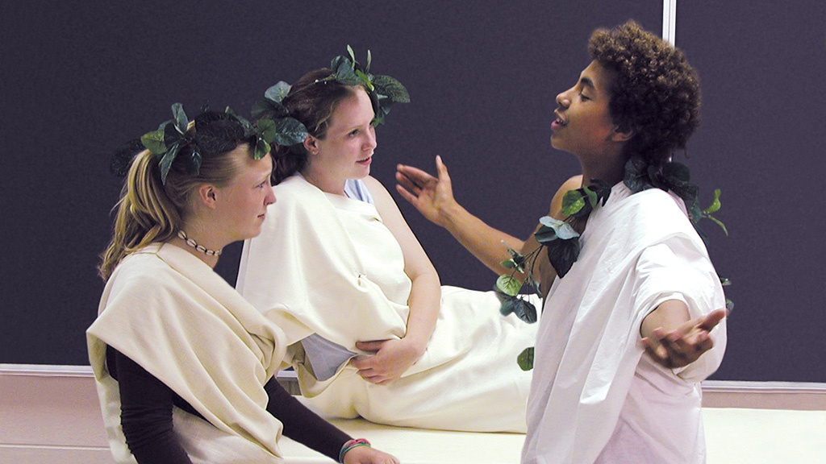


What is the Lasting Value of Simulations?
A Simulation-based Webinar
Richard Di Giacomo,
M.A. History,
author of the Role-Playing Simulation series of books from Interact

Slide 2
Agenda
The Long Term Benefits of Using Simulations
Notes:
Jeremy

Slide 3
What are Simulations?
Students assume a historical persona.
Students act/make decisions as their persona would, based upon research.
Within predetermined confines, students make choices that either recreate or change history.
By playing a role, students gain understanding of how historical decisions were made and empathy for those involved in historical changes.
Notes:
Jeremy

Slide 4
Examples of historical simulations
Notes:
Brad

Slide 5
Rationale and Use in the Social Studies
Multiple Intelligences: Affective and psych-motor
Critical thinking and multiple perspective
A real-world replication
Cooperative Learning
Piaget’s Play Theory
Bloom’s Taxonomy: Synthesis
Increased retention and conceptual learning
Increased engagement, rigor, and learning outcomes
Consistent engagement throughout activity
Better test scores
Increased interest and understanding
Support active learning strategies of International Baccalaureate schools
Notes:
Brad

Slide 6
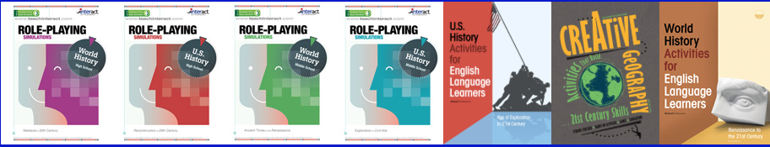
Locating Stimulating Simulations
Print-Based or E-book
Interact simulations the Role-playing Simulations series by Richard Di Giacomo and others
Social Studies School Service
www.socialstudies.com
Notes:
Brad

Slide 7
What is a role-playing simulation?
Role-playing simulations attempt to put the student in the position of a person in a particular time and place
All of the simulations involve group problem solving and conflict resolution
Usually centered around a time of crisis or decision making
Notes:
Richard

Slide 8
Two major types of role-playing simulations
Scripted
The students are given a script to read. The character they are to play is spelled out for them in advance in detail
Unscripted
Students play a part by improvisation based on general historical guidelines for a character provided by the simulation
Notes:
Richard

Slide 9
Simulations work well with concepts that are difficult to teach with other methods:
Abstract thoughts
Philosophies
Political platforms
Treaties
Negotiations
Revolutions
Complex war strategies
Instead of knocking yourself out trying to explain these difficult concepts through a dull reading, lecture, or film, it is far more effective to have students live them out by doing a simulation.
Then the concepts become their own!

Slide 10
The value of play
Kids learn by playing
They are already doing simulations when they play house, school, or army at home.
Role-playing simulations in a history class are just a natural extension of “playing make believe’ that every child already knows how to do.

Slide 11
But simulations are not just fun and games …
Never feel like you are wasting valuable class time by doing a simulation
Simulations can teach skills that no other methodology can teach
There are many desirable outcomes from simulations that simply cannot be gained from doing traditional classroom activities

Slide 12
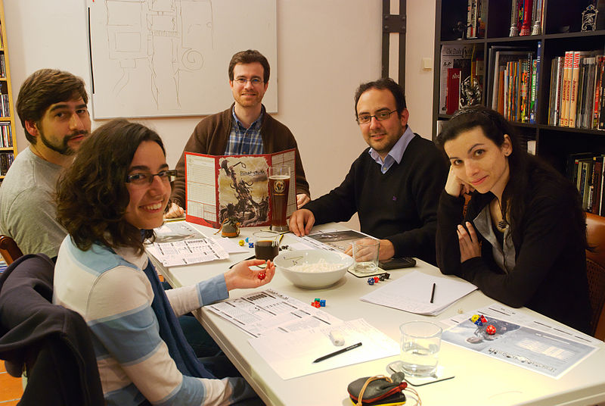
Gaming stimulates the “fun center” of the brain
These are pleasurable and enjoyable experiences that create long term memories.
We can all remember the games we won and lost years later and the fun we had trying to win them.
Simulations tap into the same creative and improvisational skills that make acting and role-playing games so popular.
No one ever falls asleep in class during a simulation!

Slide 13
Simulations foster problem solving skills
Putting students in a problem solving scenario removes them from their daily reality.
It takes critical thinking to put themselves in the shoes of others and help solve their dilemmas.
It uses abstract and higher level thinking skills to find solutions.
It helps reduce real life conflicts among students when they must work together to solve a detached problem.
This creates a transferable real life skill for future problem solving!

Slide 14
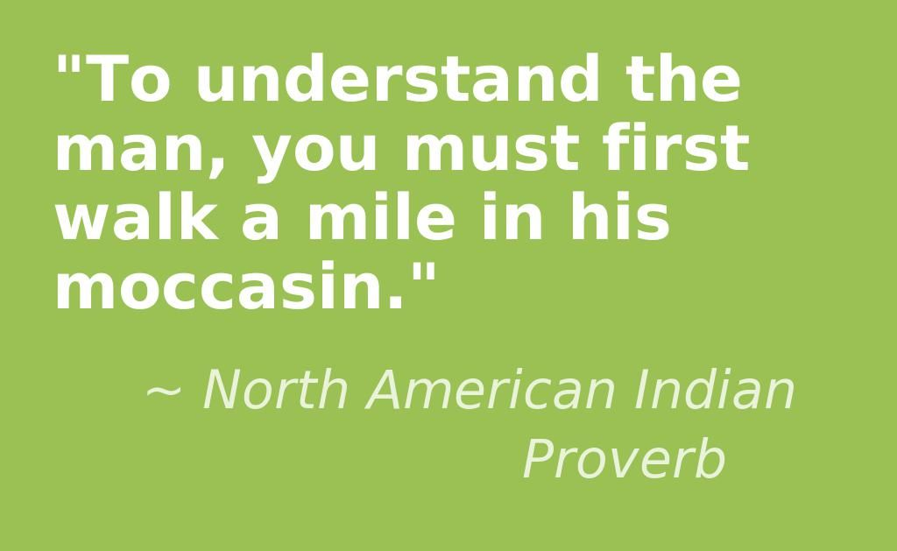
Simulations Help Develop Empathy
Remember the old parable about walking a mile in another man’s moccasins?
Simulations literally put you in the place of another person. You have to understand their world view, background, needs, and desires.
To play a role honestly and free from anachronisms, you must think as they would think, and do what they would do, not substitute your own modern values and priorities. You must become that person as an actor would.
By doing so you have to get beyond your own prejudices, biases, and preconceived notions.
This teaches you to understand others from the past better!

Slide 15
Students Learn History Without Even Realizing They Are Doing It
The students are so caught up in the fun and competition of the game, that they don’t even realize how much historical content they are absorbing while doing it.
While playing the historical roles and solving problems, they are opening a window into the thought processes of historical characters, and beginning to understand why they did what they did.

Slide 16
Simulations Are a Great Motivator
Difficult or disengaged students will participate even if they usually are not involved in class activities.
Students who like a little extra attention will thrive on the special roles they get to play.
Gifted students will have a chance to shine as they are easily able to differentiate the activity and take it to a whole new level.
All students will enjoy the change of pace from ordinary routines.

Slide 17
Simulations improve comprehension and test scores
Studies have shown that simulations help students to grasp difficult concepts better and retain them longer
Test scores and grades have improved after doing simulations
They can be used as a scaffolding activity, basic form of instruction, or authentic assessment.
They can be used to introduce or sum up a unit.
Simulations are much more than a reward or change of pace activity!

Slide 18
Simulations allow for many enrichment activities. After the simulation you can follow up with:
A debriefing including a discussion of alternate outcomes or how history might have been different with a few changes
Running the simulation again with a different time period, location, or set of characters
An essay or other assessment of what they have learned
A student made film or play
A creative writing assignment
Having students create their own simulation

Slide 19
Conclusion
Simulations work better than many traditional classroom instructional activities
They are well worth the time invested in them
They should be a regular part of every history teacher’s teaching repertoire
They have many long term educational benefits
Break out of your comfort zone and try them. You will be richly rewarded!
Notes:
Brad

Slide 20
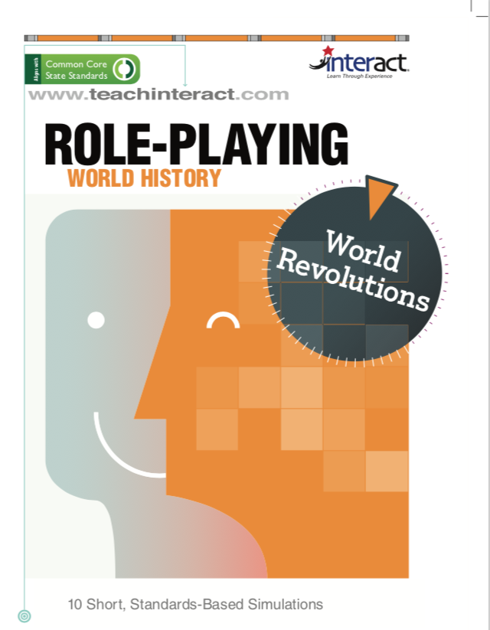
Coming soon!

Slide 21
Thank you for attending
Any questions?

Slide 22
References
Bloom, B. & Krathwohl, D. (1984). Taxonomy of Educational Objectives. Book 1: Cognitive Domain. White Plains, NY: Longman
Cyber Nation Simulations. (2008). Accessed on 6-28-2008 at www.cybernations.net
Di Giacomo, R. (2002). Short Role Playing Simulations for US History. San Jose, CA: Magnifico Publications.
Duncombe, S., & Heikkinen, M. H. (1990, January/February). Role-playing for different viewpoints. Social Studies, 81(1), 33-35.
Education Services & Staff Development Association of Central Kansas. Social Studies Central. Accessed on 6-23-2008 at http://www.socialstudiescentral.com/?q=node/88
Gardner, H. (1983). Frames of Mind: The Theory of Multiple Intelligences. New York: Basic Books.
Grauerholz, E., & Scuteri, G. M. (1989, October). Learning to role-take: A teaching technique to enhance awareness of the "other". Teaching Sociology, 17(4), 480-483.
Impact Games. (2008). Play the News. Accessed on 6-28-2008 at http://www.playthenewsgame.com/community/home.action
Kannan, S. (2008). Beyond the Fire: Teen Experiences in War. Accessed on 6-28-2008 at http://www.itvs.org/beyondthefire/
Karjala, H. E., & White, R. E. (1983, November). American history through music and role play. History Teacher, 17(1), 33-59.
Kitzerow, P. (1990, April). Active learning in the classroom: The use of group role plays. Teaching Sociology, 18(2), 223-225.
Lamey, S. (1983). Teaching About Global Awareness with Simulation and Games. Center for Teaching International Relations, Univ of Denver. Denver, CO: CTIR Publications
Lee, J. (1994). Effectiveness of the Use of Simulations in a Social Studies Classroom. Curry School of Education, University of Virginia. Eric Document Number 381448. Accessed on 5-23-2008 at http://eric.ed.gov/ERICWebPortal/custom/portlets/recordDetails/detailmini.jsp?_nfpb=true&_&ERICExtSearch_SearchValue_0=ED381448&ERICExtSearch_SearchType_0=no&accno=ED381448
Maidment, M. & Bronstein, R.H. (1973). Simulations Games: Design and Implementation. Columbus, Charles E. Merrill.
Nesbitt, W.A. (1971). Simulation Games for the Social Studies Classroom. Foreign Policy Association.
Piage, J. (1972). Development and Learning. In Lavattelly, C.S. & Stendeler, F. Reading in Child Behavior and Development. New York: Hartcourt Brace Janovich.
Population Connection (2008). A Nation of Immigrants. Washington, D.C. Accessed on 6-28-2008 at http://www.populationeducation.org/docs/300millionlessons/immigrtn.pdf
Thatcher, D. (1986). Promoting Learning Through Games and Simulations. Simulations and Games for Learning, 16(4), p. 144-154.
Van Sickle, R. L. (1990). Problem solving in social studies education: Simplifications of research on problem solving and cooperative learning. Journal of Social Studies Research, 14(1), 33-43.

