Slide 1
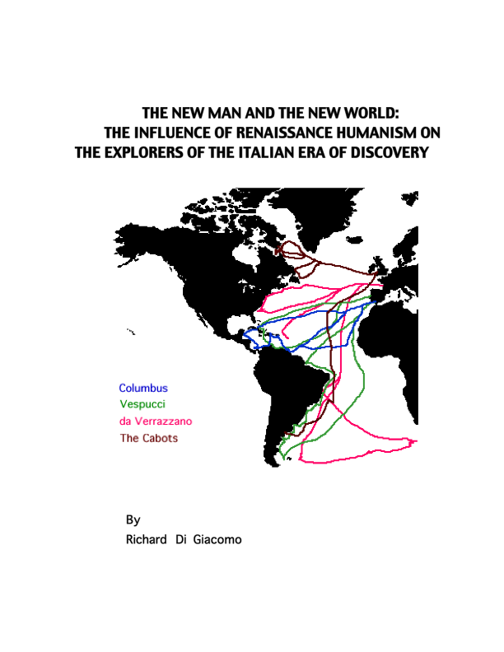

Slide 2
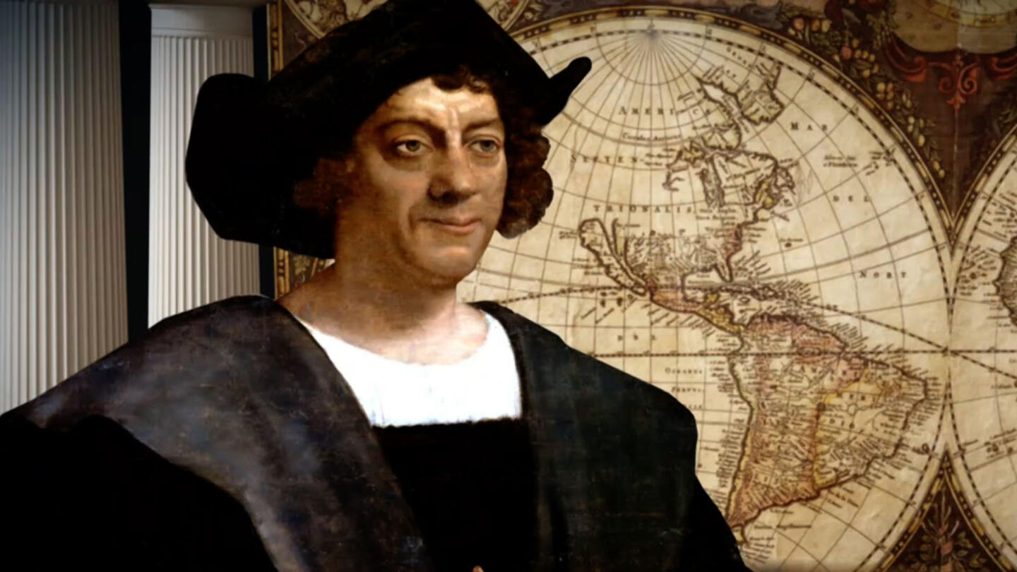
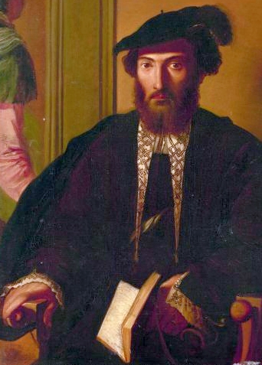
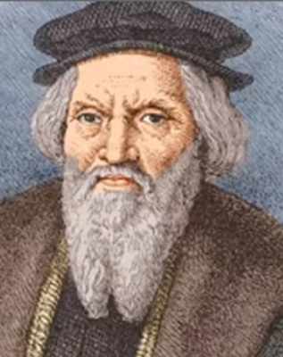
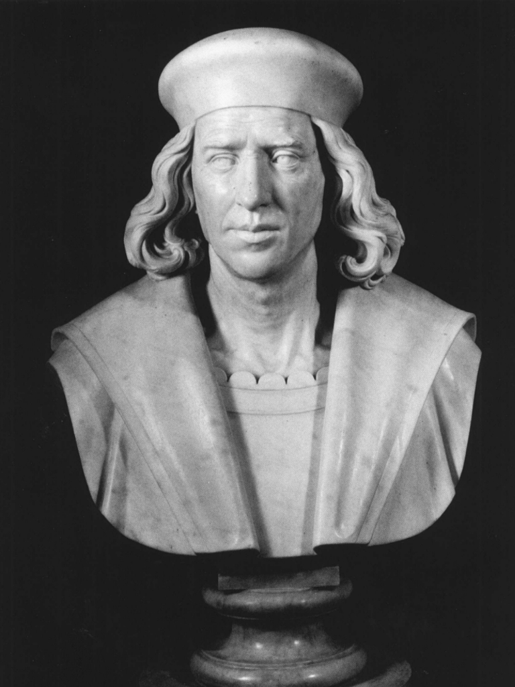
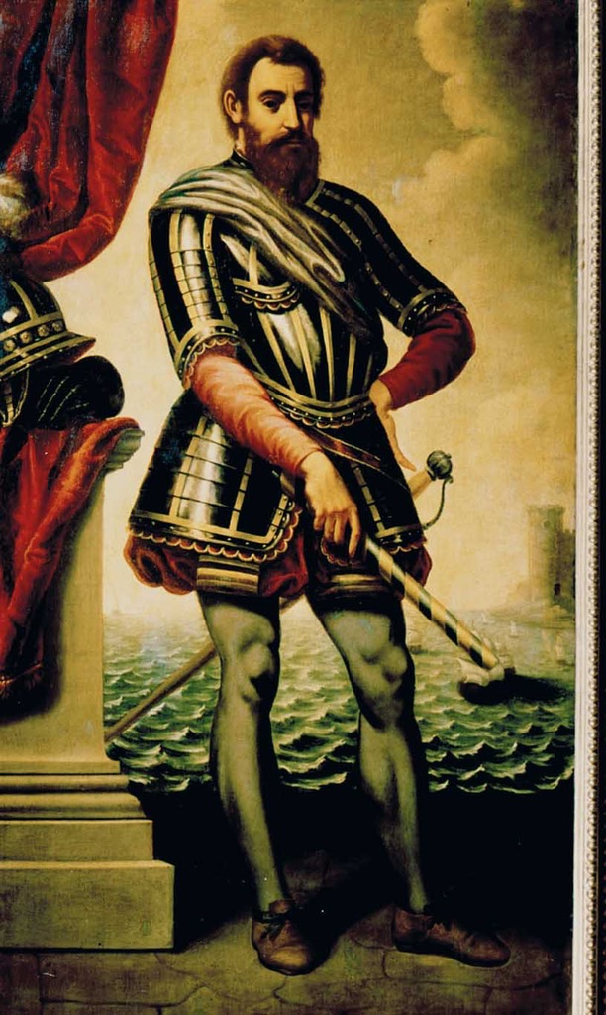
The Italian Era of Discovery:1492-1528
Cristofero Colombo
Amerigo Vespucci
Giovanni Caboto
Sebastiano Caboto
Giovanni da Verrazano
How a generation of Italian explorers introduced the rest of the world to the Americas

Slide 3
Italian Explorers led the way for others
Columbus led an entire generation of Italian discoverers who shared his goal of sailing west from Europe to reach Asia
It is estimated that 75% of the Atlantic seaboard was first explored by Italian navigators
Italian explorers such as Colombo and Vespucci trained many other explorers who sailed for Spain and Portugal
The Spanish House of Trade, an academy that supervised and trained all explorers, was headed by Vespucci
When Britain and France wanted to gain colonies too, they turned to Italian explorers
Explorers of other nationalities came later to fill in the details of coastlines and to exploit the newly-found lands for their own purposes, but without exception those who first proposed the westward voyages to America were Italians.

Slide 4
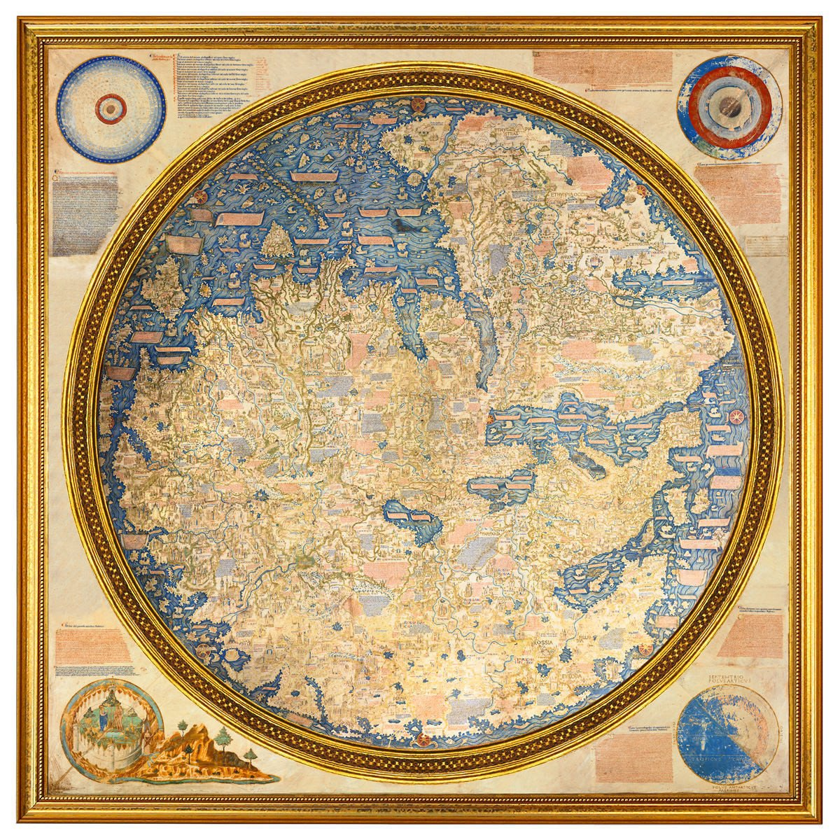
What made Italian navigators so good?
Italians had been explorers for centuries
Marco Polo: China, Mongolia, India, SE Asia and The Middle East
Zeno Brothers: Faroe Islands, possibly Nova Scotia
Ambrogio Contarini: Iran and Russia
Vandino and Ugolino Vivaldi: Africa
Niccolo de Conti: India and Southeast Asia
Antonio de Noli: Cape Verde Islands
Giovanni da Pian del Carpine: Mongol Empire
Andrea Corsali: East Indies
Veramente Dapertutto!

Slide 5
Renaissance Italy: the perfect breeding ground for voyages of discovery
Renaissance Humanism inspired exploration and influenced how the discoverers interpreted what they found
Humanism encouraged new discoveries and endeavors of every kind
Many old notions were being challenged
New inventions and philosophies were being introduced every year
Italy was the center of banking and entrepreneurial finance
It was a natural progression from thinking of themselves as a new age to the idea of the New World

Slide 6
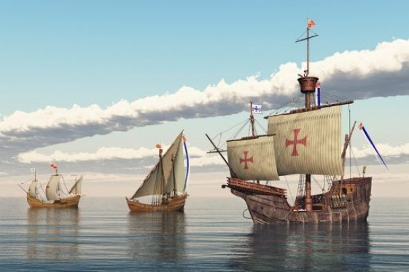
Italian merchants were the main go between for the trade between Asia and Europe since the Crusades
Italians were among the best sailors in Europe
Most of the European Medieval trade fares featured goods transported by Italians
Everyone used their navigational charts and maps and trusted them
Italians had already been to everywhere except the Americas
The traditional landward route to Asia was blocked after the fall of the Mongol Empire, so Italians were the first to propose a westward route

Slide 7
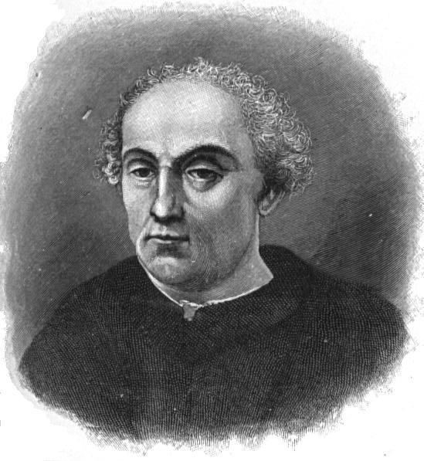
Paolo Toscanelli: An unsung hero
Dear Columbus,
Go west, young man!
He calculated that the actual distance between Europe and Asia was much shorter than the Ancients had believed and that a western passage might be conceivably made.

Slide 8
The Emergence of the Idea of a New World
The collective discoveries of Christopher Columbus, Amerigo Vespucci, John and Sebastian Cabot, and Giovanni da Verrazano constitute a distinct Italian Era of Discovery, which laid the groundwork for all other voyages that followed.
The Italian discoverers deserve a place alongside the well-known Humanists in the history of art, literature, philosophy, and government by virtue of their research and accomplishments
The explorers also made original contributions to the fields of science, navigation and cartography.

Slide 9
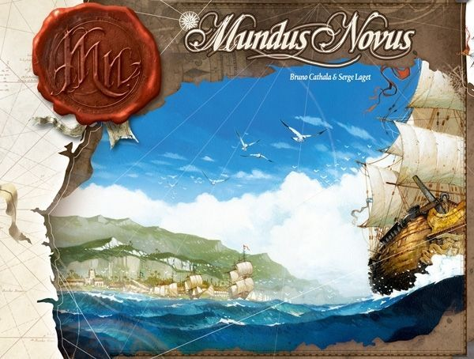
THE NEW MAN AND THE NEW WORLD
The worldview of the Italian explorers evolved to include the concept of a new world.
They had to reevaluate their cosmography and change the maps to reflect their new knowledge.
The concept of a New World was equally profound as that of a new age.
The most important contribution of the Italian explorers was not what they found, but the change in thinking that took place when they tried to explain their discoveries.

Slide 10
Columbus: The transition from the Medieval man to the Renaissance man
Things that are typically associated with a Renaissance man:
The first true awareness of man's location in time and space because of his study of geography, history, and natural philosophy.
A more accurate sense of history.
A distinct awareness of being part of a new age.
A renewed belief in the dignity of man and the importance of his actions and abilities instead of exclusive belief in external influences such as fate or divine intervention.
A new love of learning inspired by the classics, which was followed by a drive to surpass the accomplishments of the Ancients.
A disregard for the Scholasticism and rigid subject divisions of medieval universities, opting instead for a broadening of knowledge to include new subjects and research methods.
A new sense of individualism stressing fame, virtue, and civic accomplishment over piety and humility which inspired him to accomplish great deeds.
Columbus had some of these traits, but not all of them

Slide 11
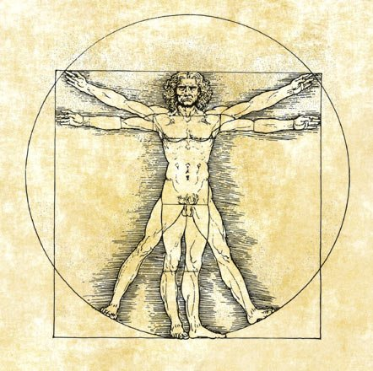
A Renaissance man
Columbus was a great scholar
He had a university education and even invented new intellectual endeavors when the colleges could teach him no more
He did extensive research in preparation for his voyages
He had many skills: cartography, astronomy, navigation, mathematics
He wrote about religion, philosophy, ethnology, law, history, and natural history.
He managed to communicate with people of several different languages that no one had ever heard before

Slide 12

And yet still medieval in many ways “Christopher Columbus had one foot in the medieval world and one in the modern” Emilio Taviani
Trusted ancient and medieval books about the transatlantic distance and where he was more than what he saw with his own eyes
Clung to the idea that he had found Asia even when faced with evidence to the contrary
He tried to make the evidence fit the theory instead of changing his world view
Believed that he was chosen by God to bring Christianity to the natives
Said he would use the money to fund a new crusade
Claimed to have found the Garden of Eden in South America

Slide 13
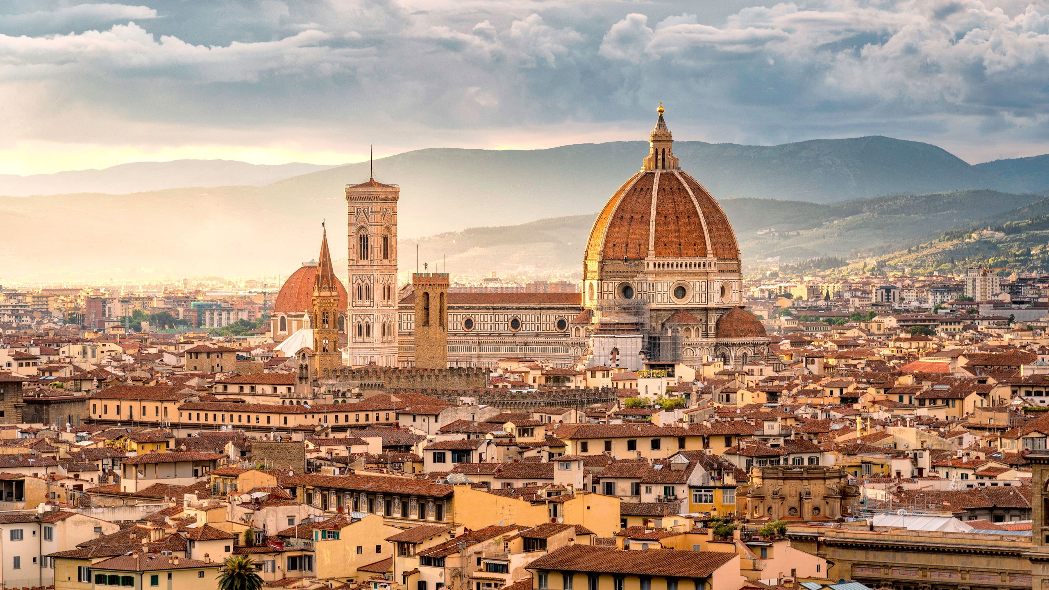
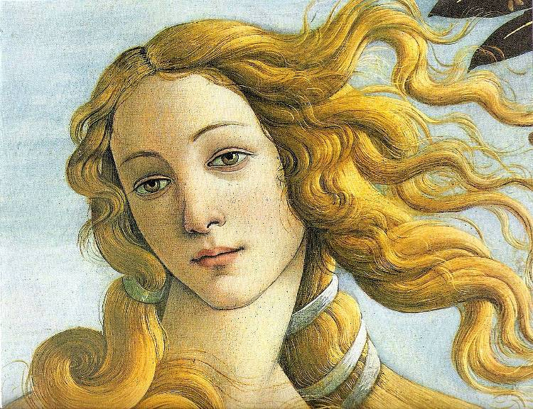
Vespucci: The first true Renaissance man
Lived in Florence, rubbed shoulders with many famous people of the Italian Renaissance
Fun fact: this is his cousin Simonetta
Had a humanistic
education and
wrote to scholars
Che bella!

Slide 14
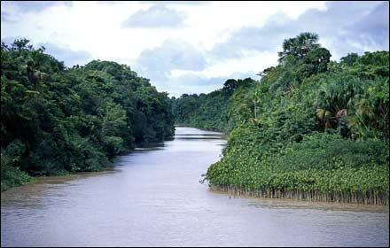
Vespucci: The actual discoverer of America
He sailed along the coast of South America
When he found the Amazon River he realized that such a large volume of water could only come from a continent not an island
Therefore he was in a new land never reported by the ancients or Marco Polo
First to use the term Mundus Novus -new world instead tierra nueva-new land like Columbus

Slide 15
Why is it called America instead of Columbia?
". . . The fourth part of the earth, which, because Amerigo discovered it, we may call Amerige, the land of Amerigo, so to speak, or America." Cosmographiae Introductio
The geographers like German, Martin Waldseemüller, had not heard of Columbus’ account because the Spanish suppressed it fearing others would steal their colonies.
Vespucci worked for the Spanish and the Portuguese
When he wrote back to his publisher friends in Florence they told the whole world about it

Slide 16
Were Columbus and Vespucci enemies?
This is a myth. They were actually friends and colleagues.
There is no documentary evidence to prove that Vespucci tried to steal Columbus’ glory
The misunderstanding arose because Vespucci’s book got published first and people began calling the land America.
Critics and followers of Columbus try to say one or the other is a fake or an usurper, but that never happened.

Slide 17
The Amazing Amerigo
Travelled many thousands of miles on his voyages
Discovered most of the South American coastline
Almost beat Magellan to the Pacific, but had to turn back just short of the tip of South America because of whiny, homesick sailors and shipworms
Made the most accurate prediction of the actual circumference of the globe until modern instruments were invented

Slide 18
The Cabots: The best father and son team in the history of exploration
They were from Venice, but lived in England for many years. That is why their names got anglicized
They went to England because they had turned Columbus down only a few years earlier
After Columbus’ success England was eager to get colonies
John Cabot made his case because he used globes skillfully to demonstrate that England was closer to Asia than Spain because the world was not as wide at the top. Both father and son were very skillful in cartography and navigation

Slide 19
The ill-fated explorer
The Cabots had to steer clear of Spanish and Portuguese claims in North America
Their discoveries became the basis for all the British colonies in North America.
John Cabot thought he had found Asia. He begged the king for a bigger fleet to go back and explore some more.
He got it, but on the second voyage, "In the event he is believed to have found the new lands nowhere but on the very bottom of the ocean, to which he is thought to have descended together with his boat, the victim himself of that self-same ocean; since after that voyage he was never seen again anywhere." Polydore Virgil

Slide 20
Sebastian vows to avenge his father
He returned to Canada, but did not find his father or the Northwest passage to Asia
People were still thinking in terms of the wealth of Asia instead of developing America
Many others followed the Cabots in search of the Northwest passage. Generations of British explorers got their inspiration from the Cabots.
Sebastian explored as far south as Florida

Slide 21

Sebastian lived a long and productive life
Sebastian went to Spain and took Vespucci’s old job as Pilot major training other explorers
The Cabots probably met Columbus and discussed plans with him
Sebastian testified on Columbus’ behalf in a lawsuit between his heirs and rivals trying to steal his money and titles
He was the only explorer to stick up for Columbus at the trial
He tried to get Venice to fund an expedition of their own, but they said they didn’t need new world colonies. They were busy enough with their empire.
He made an expedition to the Rio de Plata that ended up in disaster
When his wife died he returned to England.
He was instrumental in establishing exploration and trade editions to Canada and Russia.
He was an important cartographer and navigator
Some people get confused and conflate him and his father. This led to false claims that he pretended to discover things that his father had found.

Slide 22

da Verrazzano: an explorer of true Renaissance vintage
Also from Florence
Had humanist training
Couldn’t find any Italians to back him up because they thought they were too tied up in the Levant trade to finance anything new
Turned to the king of France instead
Talk about missed opportunities. All of the French colonies in America, could have been Italian. Caspita!
Actual wine from his villa

Slide 23
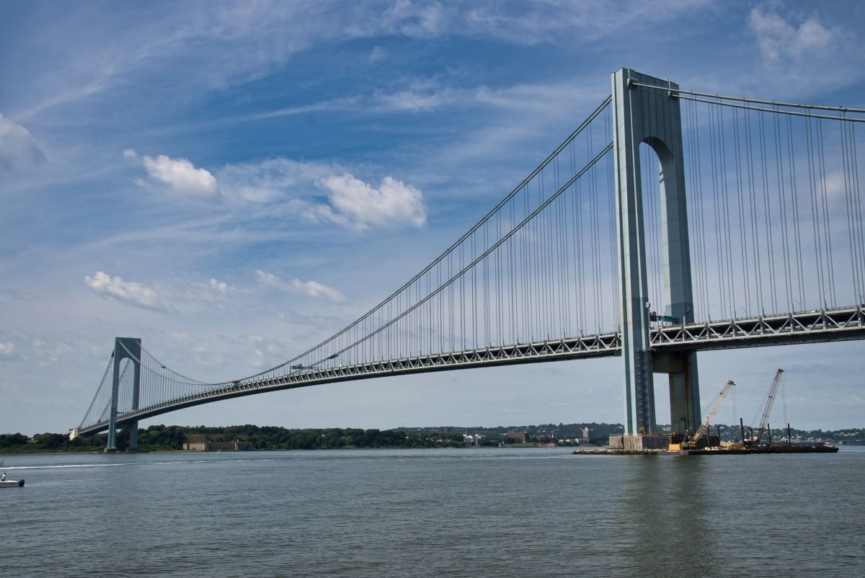
Why is there a bridge named after him?
He explored the area around New York
The only Italian explorer to actually touch what would later become the United States. (Should we change the holiday to Verrazzano Day?)

Slide 24
He changed his mind when faced with the facts
He talked to Magellan, but decided a northern route would be a faster way to get to Asia
Could only explore the gap between Spanish and English claims along the Atlantic seaboard of America
He realized he was not in Asia: “My intention on this voyage was to reach Cathay and the extreme eastern coast of Asia, but I did not expect to find such an obstacle of new land as I have found; and if for some reason I did expect to find it, I estimated there would be some strait to get through to the Eastern Ocean. This was the opinion of all the Ancients …and has been proven false by experience.”
He tried a southern passage to Asia around South America and Africa, but failed due to harsh weather

Slide 25

He had a very tough time with the Indians
He got mooned in Maine
In the Chesapeake he mistook a peace pipe for a weapon and shot the Indian
His brother watched him get eaten by cannibals in the Caribbean
He died before he could carry
out his plans to develop colonies
in the New World or find a shorter
route to Asia
Incredibly, people were still looking for the Northwest passage until the 1800s!

Slide 26
Conclusion
Italy laid the groundwork for all the other New World explorers that followed them
Italy failed to develop colonies of its own due to its disunity and preoccupation with the Levant trade. They thought they had a safe bet in Eastern trade and chose not to get involved in America. Big mistake!
Other countries used the wealth developed from Italian discoveries to build huge armies to conquer and subdue Italy for centuries

